Slide 1

SSH Tunnels A powerful tool

Slide 2


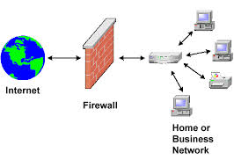


SSH tunnels usecases
Stepping stones Secure access to a remote server or network
Secure your internet traffic At the airport, in hotels
Testing from outside the company network Simulate a customers entry point
Change your location Access region limited content
Circumvent censorship Country, ISP, company

Slide 3
SSH tunnels flavors
Local Port Forwarding Forwards a connection from the client host to the SSH server host and then to the destination host port.
Remote Port Forwarding Forwards a port from the server host to the client host and then to the destination host port.
Dynamic Port Forwarding Creates SOCKS proxy server which allows communication across a range of ports.
Fixed
Client
SSH server
Remote host
SSH server
Client
Remote host
Client
SSH server
Remote host
Dynamic

Slide 4

SSH tunnel socks proxy
Client
Server
Firefox
SSH
client
SSH
server
SSH tunnel
Browser connects
to local port
Local TCP port
8123
SSH server
Connects to
websites
Client opens
local port

Slide 5
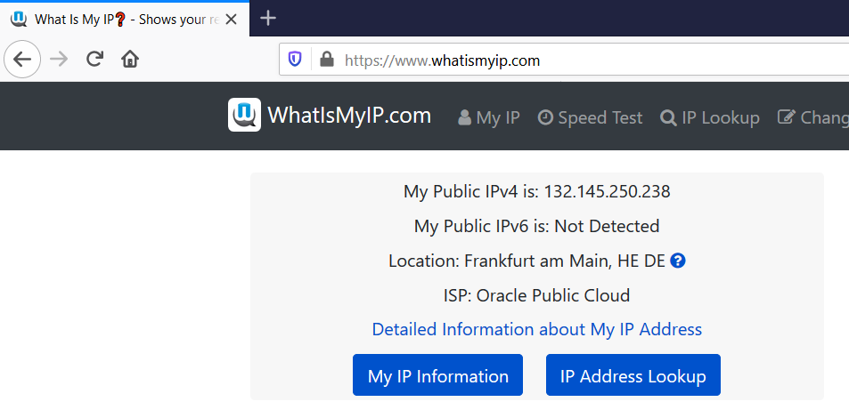

Slide 6
SSH tunnels compared to VPN
 | SSH tunnel | VPN
Server (usually) | Do it yourself | Provided
Technology | SSH | NSA compromised - L2TP, IKE, IPSec Not known to be compromised: - OpenVPN, WireGuard, IKEv2
Ports used | Single port, configurable | Differs per technology
Connection stability | SSH client based | Differs per technology
Bridges | Connection | Network
Ease to setup | Very easy (SSH server required) | Moderately easy Setting up your own VPN server is not easy Using a VPN providers service is easy
Ease of access | Very easy | Depends on where you are if you can access the VPN (differs per technology)
Weakest link | SSH server Often self-managed | VPN provider
Ease of location change | Difficult (requires server per region) Use Tor for that! | Easy (VPN provider provides servers in different regions)
Anonymity | SSH servers / accounts are personal (only you have a specific source IP) | VPN servers are shared (many people have the same source IP)

